Slide 1

Processing Next Generation Sequencing data the NGsane way
You can change this image to be appropriate for your topic by inserting an image in this space or use the alternate title slide with lines. Note: only one image should be used and do not overlap the title text.
Enter your Business Unit or Flagship name in the ribbon above the url.
Add collaborator logos in the white space below the ribbon.
[delete instructions before use]
By restlessglobetrotter
Denis C. Bauer | Research Scientist, CMIS
23 January 2014
CCI

Slide 2
Sequencing data is everywhere
Encode (Encyclopedia of DNA Elements)
HEP (human epigenome project)
TCGA (the cancer genome atlas)
Genome 10K Project
...
all need some initial processing

Slide 3
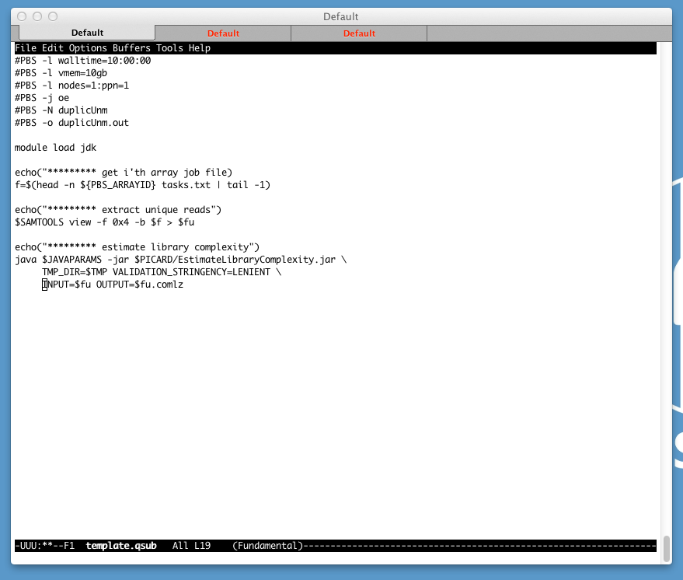
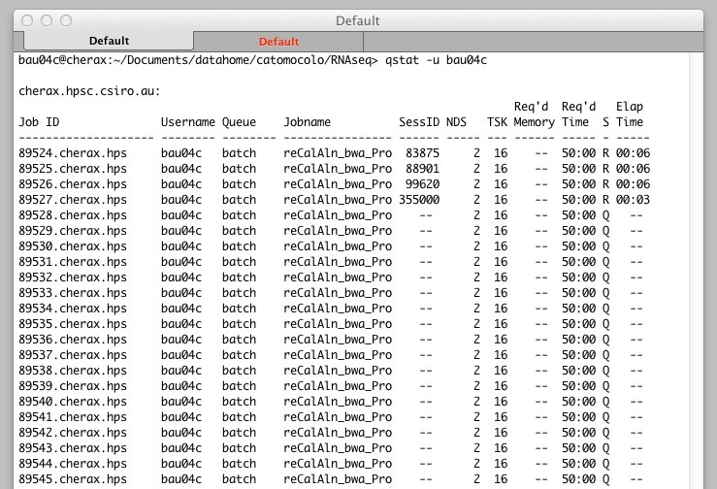
Resource consumption
Script
2.7T DNAseq, 12 individuals, 36 samples on average 128 hours real time (ste= 15)
77 GB RAM (ste=0.34)
Submission
qsub –t 1-12 task.qsub
Scheduler
CPU
(hours)
Real time
(hours)
Memory
(GB)
Notes:
94.45+24.57+(7.02e+00)+2.25
12.97+0.90+(1.31e+00)+0.05
11%
49.63+16.53+(9.71e-01)+9.64
0.01+0.01+(1.65e-01)+0.15

Slide 4
Bundle Tasks in Modules
Input
(e.g. line.fastq)
Modular conceptual blocks
Plug & Play
Native module construction
bwa aln
bwa sampe
samtools index
dedup
…
Raw
reads
Variants
Raw
reads
TFBS sites
Output
(e.g. line.bam)
Raw
reads
Transcripts

Slide 5
Production Informatics and Bioinformatics
Product | Time
fastq | 5 days
bam, vcf,… | 3 weeks
paper | >6 months
Produce raw sequence reads
Basic Production
Informatics
Map to genome and generate raw genomic features (e.g. SNPs)
Advanced
Production Inform.
Analyze the data; Uncover the biological meaning
How to get here faster?
Bioinformatics
Research
Per one-flowcell project

Slide 6
Wish List for a framework
reproducibility
reusability
cutting edge
data security
robustness
adaptability
pipelining
simplicity
HPC environment
knowledge transfer

Slide 7
Reasonable Partitioning
Scripts
(pipelines,
job submission,
data handling)
Raw data
(fastq)
Results
(bam,
quality metrics)
Software
(Aligner, etc)
Advanced Production Informatics

Slide 8
NGSANE: NEXT GENERATION SEQUENCE ANALYSIS ENTERPRISE
Lightweight production informatics framework based on Bash
a set of scripts that chain together different programs and define computer environments needed to run bioinformatics software on our data using an HPC cluster
Aim
Minimise project set-up overhead while providing easily adaptable processing modules

Slide 9

NGSANE
Concept

Slide 10
Project setup
Create a project folder and a fastq folder therein
Create (as many) context folders as needed within the fastq directory and put your raw data there
Copy sample config files for required tasks and adjust settings
Fastq
Sub1
Sub2
Project
config
s_1_read1.fastq
s_1_read2.fastq
s_2_read1.fastq
s_2_read2.fastq
s_3_read1.fastq
s_3_read2.fastq
s_4_read1.fastq
s_4_read2.fastq

Slide 11
The Trigger - 3 simple steps (+coffee)
Setup project on HPC
Load module (gives you access to the trigger)
module load gi/ngsane/<version>
Check what you want to do (dry run)
trigger.sh config.txt
Get things done (submit jobs)
trigger.sh config.txt armed
trigger.sh
config.txt
config.txt
trigger.sh
config.txt
armed
Spawn len(*.fastq) parallel jobs
... treat yourself to a coffee and do other stuff while the jobs are running

Slide 12
Folder-structure after job finish
Fastq
Sub1
Sub2
qout
bwa
reCaAl
Variants
Sub2
Sub1
Bwa
reCaAl
Bwa
reCal
Project
Summary
config
s_1_read1.fastq
s_1_read2.fastq
s_2_read1.fastq
s_2_read2.fastq
s_3_read1.fastq
s_3_read2.fastq
s_4_read1.fastq
s_4_read2.fastq
Sub1_s_1.out
Sub1_s_2.out
Sub2_s_3.out
Sub2_s_4.out
Sub1_s_1.out
Sub1_s_2.out
Sub2_s_3.out
Sub2_s_4.out
s_1.bam
s_2.bam
s_1.ashrr.bam
s_2.ashrr.bam
s_3.bam
s_4.bam
s_3.ashrr.bam
s_4.ashrr.bam
A unified folder structure allows other researcher/lab
members (familiar with it) to understand what to did.

Slide 13
There is more
Validate and summarize outcome
trigger.sh config.txt html
trigger.sh
config.txt
html

Slide 14
DEMO – dry run
bau04c@burnet-login:/NGSANEDEMO> trigger.sh config.txt
[NGSANE] Trigger mode: [empty] (dry run)
[NOTE] Folders: RunMore
[Task] bowtie2
[NOTE] setup enviroment
[TODO] RunMore/Run1_read1.fastq
[TODO] RunMore/Run2_read1.fastq
[TODO] RunMore/Run3_read1.fastq
[NOTE] proceeding with job scheduling...
[NOTE] make RunMore/bowtie2/Run1.asd.bam.dummy
[ JOB] /apps/gi/ngsane/0.4.0.1//mods/bowtie2.sh -k /NGSANEDEMO/config.txt -f /NGSANEDEMO/fastq/RunMore/Run1_read1.fastq -o /NGSANEDEMO/RunMore/bowtie2 --rgsi RunMore
[NOTE] make RunMore/bowtie2/Run2.asd.bam.dummy
[ JOB] /apps/gi/ngsane/0.4.0.1//mods/bowtie2.sh -k /NGSANEDEMO/config.txt -f /NGSANEDEMO/fastq/RunMore/Run2_read1.fastq -o /NGSANEDEMO/RunMore/bowtie2 --rgsi RunMore
[NOTE] make RunMore/bowtie2/Run3.asd.bam.dummy
[ JOB] /apps/gi/ngsane/0.4.0.1//mods/bowtie2.sh -k /NGSANEDEMO/config.txt -f /NGSANEDEMO/fastq/RunMore/Run3_read1.fastq -o /NGSANEDEMO/RunMore/bowtie2 --rgsi RunMore

Slide 15
DEMO – submit
bau04c@burnet-login:/NGSANEDEMO> trigger.sh config.txt armed
[NGSANE] Trigger mode: armed
Double check! Then type safetyoff and hit enter to launch the job: safetyoff
... take cover!
[NOTE] Folders: RunMore
[Task] bowtie2
[NOTE] setup enviroment
[TODO] RunMore/Run1_read1.fastq
[TODO] RunMore/Run2_read1.fastq
[TODO] RunMore/Run3_read1.fastq
[NOTE] proceeding with job scheduling...
[NOTE] make RunMore/bowtie2/Run1.asd.bam.dummy
[ JOB] /apps/gi/ngsane/0.4.0.1//mods/bowtie2.sh -k /NGSANEDEMO/config.txt -f /NGSANEDEMO/fastq/RunMore/Run1_read1.fastq -o /NGSANEDEMO/RunMore/bowtie2 --rgsi RunMore
Jobnumber 2424899
[NOTE] make RunMore/bowtie2/Run2.asd.bam.dummy
[ JOB] /apps/gi/ngsane/0.4.0.1//mods/bowtie2.sh -k /NGSANEDEMO/config.txt -f /NGSANEDEMO/fastq/RunMore/Run2_read1.fastq -o /NGSANEDEMO/RunMore/bowtie2 --rgsi RunMore
Jobnumber 2424900
[NOTE] make RunMore/bowtie2/Run3.asd.bam.dummy
[ JOB] /apps/gi/ngsane/0.4.0.1//mods/bowtie2.sh -k /NGSANEDEMO/config.txt -f /NGSANEDEMO/fastq/RunMore/Run3_read1.fastq -o /NGSANEDEMO/RunMore/bowtie2 --rgsi RunMore
Jobnumber 2424901

Slide 16
DEMO – scheduler
bau04c@burnet-login:/NGSANEDEMO> qstat -u bau04c
burnet-srv.idpx.hpsc.csiro.au:
Req'd Req'd Elap
Job ID Username Queue Jobname SessID NDS TSK Memory Time S Time
-------------------- ----------- -------- ---------------- ------ ----- ------ ------ ----- - -----
2424899.burnet-s bau04c normal NGs_bowtie2_RunM 9085 1 2 -- 00:05 R 00:00
2424900.burnet-s bau04c normal NGs_bowtie2_RunM 9178 1 2 -- 00:05 R 00:00
2424901.burnet-s bau04c normal NGs_bowtie2_RunM 9353 1 2 -- 00:05 R 00:00

Slide 17
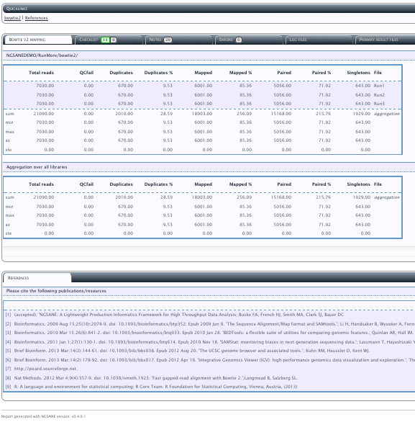
DEMO – report
bau04c@burnet-login:/NGSANEDEMO> trigger.sh config.txt html
[NGSANE] Trigger mode: html
>>>>> Generate HTML report
>>>>> startdate Fri Jan 24 08:02:37 EST 2014
>>>>> hostname burnet-login
>>>>> makeSummary.sh -k /NGSANEDEMO/config.txt
--R --R version 3.0.0 (2013-04-03) -- "Masked Marvel”
--Python--Python 2.7.2
QC - bowtie2
>>>>> Generate HTML report - FINISHED
>>>>> enddate Fri Jan 24 08:02:39 EST 2014
More report examples

Slide 18
NGSANE does
provide production informatics for NGS experiments (defined as data processing required to convert raw fastq data into aligned reads or calls on differential gene expression etc pp)
enhance productivity by reducing overhead of set-up and scripting for new projects
enable efficient use of cluster resources by separating the data from the programs operating on them
promote experimental reproducibility by documenting workflow and programs (version) used to process the raw data
provide a unified framework (e.g. common folder structure ) for processing of raw data obtained from different experimental protocols. This helps lab members familiar with the framework to understand their colleagues work, which can be crucial when somebody is not available or has move on to new challenges outside Garvan.
provides distributed data processing thus allowing us to do the interesting analysis earlier (HPC cluster is required)
generates a high level summary html file to enable informed decisions about the experimental success
provide an access point for new lab bioinformatics members/collaborators

Slide 19
NGSANE does NOT
does not expose any kind of data (raw or processed) to other labs or the public
does not slow down software incorporation (needing GUI parameter definitions, customized wrappers, language-specific overhead)
does not automatically analyze data with respect to a specific research question
does not take the responsibility from you of you knowing what you are doing and what the results mean

Slide 20
NGSANE is Meant to
Be by bioinformaticians for bioinformaticians
Be a community effort
chip in if you are an expert on a topic
no pressure though - take what you need
Iterative / Sequencial (run a task at a time and check quality measures)
Be easily repeatable (tasks can be re-submitted for individual files)
Flexible
Anything can be overwritten easily
new software can be incorporated easily (i.e. directly from the bash development script)

Slide 21
NGSANE Currently supports
Transfer data (smbclient)
Quality Control
(GATK, FastQC, RNA-SeQC, custom summaries, user code)
Trimming
(Cutadapt,Trimgalore, Trimmomatic)
Mapping
(BWA,Bowtie1,Bowtie2,Tophat)
Transcript Quantification
(cufflinks, htseq, bedtools)
Variant calling
(GATK, samtools)
Variant annotation
(annovar)
3D Genome structure
(Hicup, fit-hi-c, Hiclib, Homer)

Slide 22


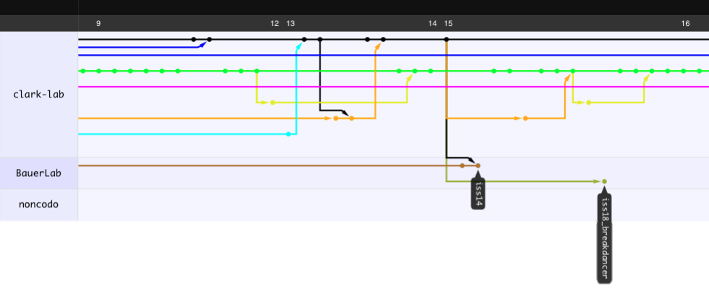
How to get it: Fork from github
https://github.com/BauerLab/ngsane
denis.bauer@csiro.au
[Photo Credit: ryancr]

Slide 23




Deploying NGSANE on Amazon Elastic Cloud
Elastic Cloud Compute
AMIs
Master Compute Nodes
Notes:
http://www.amazon.com/gp/feature.html/ref=cd_def?ie=UTF8&*Version*=1&*entries*=0&docId=1000828861
http://www.clker.com/clipart-14649.html

Slide 24
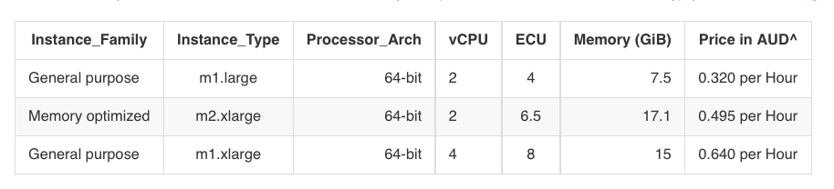
Virtual Cluster
NODE_IMAGE_ID = ami-09c45b33
NODE_INSTANCE_TYPE = t1.micro
CLUSTER_SIZE = 2

Slide 25
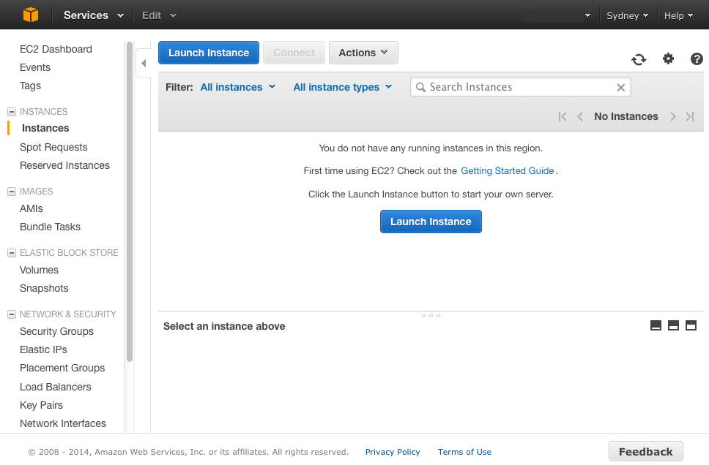
DEMO – dashboard

Slide 26
DEMO – config file
aceymac-nh:.starcluster bau04c$ grep INSTANCE_TYPE config
NODE_INSTANCE_TYPE = t1.micro
#MASTER_INSTANCE_TYPE = m1.small
#NODE_INSTANCE_TYPE = c1.xlarge
aceymac-nh:.starcluster bau04c$ grep CLUSTER_SIZE config
CLUSTER_SIZE = 2
# CLUSTER_SIZE=16

Slide 27
DEMO – start cluster
aceymac-nh:.starcluster bau04c$ starcluster start mycluster
StarCluster - (http://star.mit.edu/cluster) (v. 0.94.2)
Software Tools for Academics and Researchers (STAR)
Please submit bug reports to starcluster@mit.edu
>>> Using default cluster template: smallcluster
>>> Validating cluster template settings...
>>> Cluster template settings are valid
>>> Starting cluster...
>>> Launching a 2-node cluster...
>>> Creating security group @sc-mycluster...
Reservation:r-15f9492a
>>> Waiting for instances to propagate...
>>> Waiting for cluster to come up... (updating every 30s)
>>> Waiting for all nodes to be in a 'running' state...
2/2 |||||||||||||||||||||||||||||||||||||||||||||||||||||||||||||||||||| 100%
>>> Waiting for SSH to come up on all nodes...
2/2 |||||||||||||||||||||||||||||||||||||||||||||||||||||||||||||||||||| 100%
>>> Waiting for cluster to come up took 1.081 mins
>>> The master node is ec2-54-206-27-157.ap-southeast-2.compute.amazonaws.com
>>> Configuring cluster...
>>> Running plugin starcluster.clustersetup.DefaultClusterSetup
>>> Configuring hostnames...
2/2 |||||||||||||||||||||||||||||||||||||||||||||||||||||||||||||||||||| 100%
>>> Creating cluster user: sgeadmin (uid: 1001, gid: 1001)
2/2 |||||||||||||||||||||||||||||||||||||||||||||||||||||||||||||||||||| 100%
>>> Configuring scratch space for user(s): sgeadmin
2/2 |||||||||||||||||||||||||||||||||||||||||||||||||||||||||||||||||||| 100%
>>> Configuring /etc/hosts on each node
2/2 |||||||||||||||||||||||||||||||||||||||||||||||||||||||||||||||||||| 100%
>>> Starting NFS server on master
>>> Configuring NFS exports path(s):
/home
>>> Mounting all NFS export path(s) on 1 worker node(s)
1/1 |||||||||||||||||||||||||||||||||||||||||||||||||||||||||||||||||||| 100%
>>> Setting up NFS took 0.029 mins
>>> Configuring passwordless ssh for root
>>> Configuring passwordless ssh for sgeadmin
>>> Running plugin starcluster.plugins.sge.SGEPlugin
>>> Configuring SGE...
>>> Configuring NFS exports path(s):
/opt/sge6
>>> Mounting all NFS export path(s) on 1 worker node(s)
1/1 |||||||||||||||||||||||||||||||||||||||||||||||||||||||||||||||||||| 100%
>>> Setting up NFS took 0.018 mins
>>> Removing previous SGE installation...
>>> Installing Sun Grid Engine...
1/1 |||||||||||||||||||||||||||||||||||||||||||||||||||||||||||||||||||| 100%
>>> Creating SGE parallel environment 'orte'
2/2 |||||||||||||||||||||||||||||||||||||||||||||||||||||||||||||||||||| 100%
>>> Adding parallel environment 'orte' to queue 'all.q'
>>> Configuring cluster took 0.472 mins
>>> Starting cluster took 1.614 mins
Notes:
aceymac-nh:.starcluster bau04c$ starcluster start mycluster
StarCluster - (http://star.mit.edu/cluster) (v. 0.94.2)
Software Tools for Academics and Researchers (STAR)
Please submit bug reports to starcluster@mit.edu
>>> Using default cluster template: smallcluster
>>> Validating cluster template settings...
>>> Cluster template settings are valid
>>> Starting cluster...
>>> Launching a 2-node cluster...
>>> Creating security group @sc-mycluster...
Reservation:r-15f9492a
>>> Waiting for instances to propagate...
>>> Waiting for cluster to come up... (updating every 30s)
>>> Waiting for all nodes to be in a 'running' state...
2/2 |||||||||||||||||||||||||||||||||||||||||||||||||||||||||||||||||||| 100%
>>> Waiting for SSH to come up on all nodes...
2/2 |||||||||||||||||||||||||||||||||||||||||||||||||||||||||||||||||||| 100%
>>> Waiting for cluster to come up took 1.081 mins
>>> The master node is ec2-54-206-27-157.ap-southeast-2.compute.amazonaws.com
>>> Configuring cluster...
>>> Running plugin starcluster.clustersetup.DefaultClusterSetup
>>> Configuring hostnames...
2/2 |||||||||||||||||||||||||||||||||||||||||||||||||||||||||||||||||||| 100%
>>> Creating cluster user: sgeadmin (uid: 1001, gid: 1001)
2/2 |||||||||||||||||||||||||||||||||||||||||||||||||||||||||||||||||||| 100%
>>> Configuring scratch space for user(s): sgeadmin
2/2 |||||||||||||||||||||||||||||||||||||||||||||||||||||||||||||||||||| 100%
>>> Configuring /etc/hosts on each node
2/2 |||||||||||||||||||||||||||||||||||||||||||||||||||||||||||||||||||| 100%
>>> Starting NFS server on master
>>> Configuring NFS exports path(s):
/home
>>> Mounting all NFS export path(s) on 1 worker node(s)
1/1 |||||||||||||||||||||||||||||||||||||||||||||||||||||||||||||||||||| 100%
>>> Setting up NFS took 0.029 mins
>>> Configuring passwordless ssh for root
>>> Configuring passwordless ssh for sgeadmin
>>> Running plugin starcluster.plugins.sge.SGEPlugin
>>> Configuring SGE...
>>> Configuring NFS exports path(s):
/opt/sge6
>>> Mounting all NFS export path(s) on 1 worker node(s)
1/1 |||||||||||||||||||||||||||||||||||||||||||||||||||||||||||||||||||| 100%
>>> Setting up NFS took 0.018 mins
>>> Removing previous SGE installation...
>>> Installing Sun Grid Engine...
1/1 |||||||||||||||||||||||||||||||||||||||||||||||||||||||||||||||||||| 100%
>>> Creating SGE parallel environment 'orte'
2/2 |||||||||||||||||||||||||||||||||||||||||||||||||||||||||||||||||||| 100%
>>> Adding parallel environment 'orte' to queue 'all.q'
>>> Configuring cluster took 0.472 mins
>>> Starting cluster took 1.614 mins
The cluster is now ready to use. To login to the master node
as root, run:
$ starcluster sshmaster mycluster
If you're having issues with the cluster you can reboot the
instances and completely reconfigure the cluster from
scratch using:
$ starcluster restart mycluster
When you're finished using the cluster and wish to terminate
it and stop paying for service:
$ starcluster terminate mycluster
Alternatively, if the cluster uses EBS instances, you can
use the 'stop' command to shutdown all nodes and put them
into a 'stopped' state preserving the EBS volumes backing
the nodes:
$ starcluster stop mycluster
WARNING: Any data stored in ephemeral storage (usually /mnt)
will be lost!
You can activate a 'stopped' cluster by passing the -x
option to the 'start' command:
$ starcluster start -x mycluster
This will start all 'stopped' nodes and reconfigure the
cluster.

Slide 28
DEMO – log-in
aceymac-nh:.starcluster bau04c$ starcluster sshmaster mycluster
StarCluster - (http://star.mit.edu/cluster) (v. 0.94.2)
Software Tools for Academics and Researchers (STAR)
Please submit bug reports to starcluster@mit.edu
The authenticity of host 'ec2-54-206-27-157.ap-southeast-2.compute.amazonaws.com (54.206.27.157)' can't be established.
RSA key fingerprint is 3c:d3:0a:dd:79:37:20:4d:9b:96:a4:11:53:f4:1d:37.
Are you sure you want to continue connecting (yes/no)? yes
Warning: Permanently added 'ec2-54-206-27-157.ap-southeast-2.compute.amazonaws.com,54.206.27.157' (RSA) to the list of known hosts.
_ _ _
__/\_____| |_ __ _ _ __ ___| |_ _ ___| |_ ___ _ __
\ / __| __/ _` | '__/ __| | | | / __| __/ _ \ '__|
/_ _\__ \ || (_| | | | (__| | |_| \__ \ || __/ |
\/ |___/\__\__,_|_| \___|_|\__,_|___/\__\___|_|
StarCluster Ubuntu 12.04 AMI
Software Tools for Academics and Researchers (STAR)
Homepage: http://star.mit.edu/cluster
Documentation: http://star.mit.edu/cluster/docs/latest
Code: https://github.com/jtriley/StarCluster
Mailing list: starcluster@mit.edu
This AMI Contains:
* Open Grid Scheduler (OGS - formerly SGE) queuing system
* Condor workload management system
* OpenMPI compiled with Open Grid Scheduler support
* OpenBLAS- Highly optimized Basic Linear Algebra Routines
* NumPy/SciPy linked against OpenBlas
* IPython 0.13 with parallel support
* and more! (use 'dpkg -l' to show all installed packages)
Open Grid Scheduler/Condor cheat sheet:
* qstat/condor_q - show status of batch jobs
* qhost/condor_status- show status of hosts, queues, and jobs
* qsub/condor_submit - submit batch jobs (e.g. qsub -cwd ./job.sh)
* qdel/condor_rm - delete batch jobs (e.g. qdel 7)
* qconf - configure Open Grid Scheduler system
Current System Stats:
System load: 0.29 Processes: 88
Usage of /: 75.1% of 9.84GB Users logged in: 0
Memory usage: 17% IP address for eth0: 172.31.2.28
Swap usage: 0%
Last login: Mon Nov 25 16:23:46 2013 from 141.80.150.211
Notes:
StarCluster - (http://star.mit.edu/cluster) (v. 0.94.2)
Software Tools for Academics and Researchers (STAR)
Please submit bug reports to starcluster@mit.edu
The authenticity of host 'ec2-54-206-27-157.ap-southeast-2.compute.amazonaws.com (54.206.27.157)' can't be established.
RSA key fingerprint is 3c:d3:0a:dd:79:37:20:4d:9b:96:a4:11:53:f4:1d:37.
Are you sure you want to continue connecting (yes/no)? yes
Warning: Permanently added 'ec2-54-206-27-157.ap-southeast-2.compute.amazonaws.com,54.206.27.157' (RSA) to the list of known hosts.
_ _ _
__/\_____| |_ __ _ _ __ ___| |_ _ ___| |_ ___ _ __
\ / __| __/ _` | '__/ __| | | | / __| __/ _ \ '__|
/_ _\__ \ || (_| | | | (__| | |_| \__ \ || __/ |
\/ |___/\__\__,_|_| \___|_|\__,_|___/\__\___|_|
StarCluster Ubuntu 12.04 AMI
Software Tools for Academics and Researchers (STAR)
Homepage: http://star.mit.edu/cluster
Documentation: http://star.mit.edu/cluster/docs/latest
Code: https://github.com/jtriley/StarCluster
Mailing list: starcluster@mit.edu
This AMI Contains:
* Open Grid Scheduler (OGS - formerly SGE) queuing system
* Condor workload management system
* OpenMPI compiled with Open Grid Scheduler support
* OpenBLAS- Highly optimized Basic Linear Algebra Routines
* NumPy/SciPy linked against OpenBlas
* IPython 0.13 with parallel support
* and more! (use 'dpkg -l' to show all installed packages)
Open Grid Scheduler/Condor cheat sheet:
* qstat/condor_q - show status of batch jobs
* qhost/condor_status- show status of hosts, queues, and jobs
* qsub/condor_submit - submit batch jobs (e.g. qsub -cwd ./job.sh)
* qdel/condor_rm - delete batch jobs (e.g. qdel 7)
* qconf - configure Open Grid Scheduler system
Current System Stats:
System load: 0.29 Processes: 88
Usage of /: 75.1% of 9.84GB Users logged in: 0
Memory usage: 17% IP address for eth0: 172.31.2.28
Swap usage: 0%

Slide 29
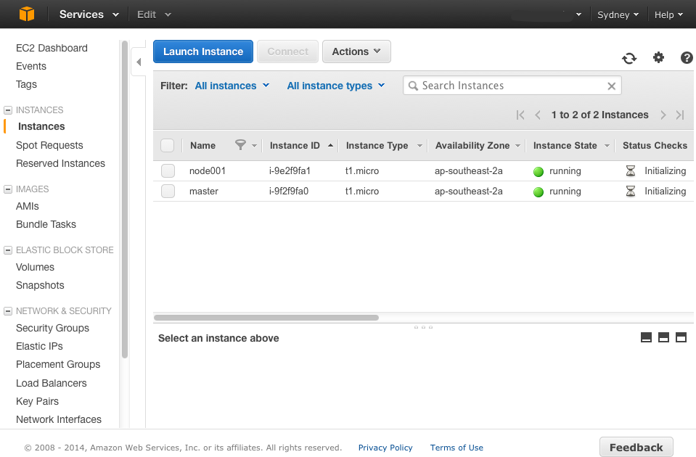
DEMO – dashboard

Slide 30
DEMO – launch jobs + NGSANE
root@master:~# su – sgeadmin
sgeadmin@master:~$ ls
referenceData smokebox test.qsub
sgeadmin@master:~$ qsub -V -t 1-4 test.qsub
Your job-array 1.1-4:1 ("blast") has been submitted
sgeadmin@master:~$ qstat
job-ID prior name user state submit/start at queue slots ja-task-ID
----------------------------------------------------------------------------------------------------- 1 0.00000 blast sgeadmin qw 01/23/2014 21:26:39 1 1-4:1
sgeadmin@master:~$ ls
blast.o1.1 blast.o1.2 blast.o1.3 blast.o1.4 referenceData smokebox test.qsub
sgeadmin@master:~$ cat blast.o1.*
>>>>> blast.o1.1
>>>>> hostname master array ID 1
>>>>> blast.o1.2
>>>>> hostname node001 array ID 2
>>>>> blast.o1.4
>>>>> hostname master array ID 3
>>>>> blast.o1.4
>>>>> hostname node001 array ID 4
sgeadmin@master:~$ module load ngsane
sgeadmin@master:~$ trigger.sh smokebox/config.txt armed

Slide 31
DEMO - logout
sgeadmin@master:~$ exit
logout
root@master:~# exit
logout
Connection to ec2-54-206-27-157.ap-southeast-2.compute.amazonaws.com closed.
aceymac-nh:.starcluster bau04c$ starcluster terminate mycluster
StarCluster - (http://star.mit.edu/cluster) (v. 0.94.2)
Software Tools for Academics and Researchers (STAR)
Please submit bug reports to starcluster@mit.edu
Terminate EBS cluster mycluster (y/n)? y
>>> Running plugin starcluster.plugins.sge.SGEPlugin
>>> Running plugin starcluster.clustersetup.DefaultClusterSetup
>>> Terminating node: master (i-9f2f9fa0)
>>> Terminating node: node001 (i-9e2f9fa1)
>>> Waiting for cluster to terminate...
>>> Removing @sc-mycluster security group...

Slide 32
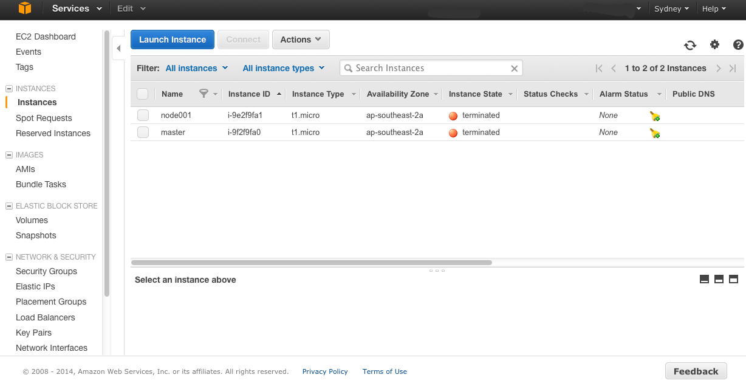
DEMO - dashboard

Slide 33
NGSANE
Produce raw sequence reads
Basic Production
Informatics
Project
configs (task)
Scripts
trigger.sh
<tasks>.sh
Map to genome and generate raw genomic features (e.g. SNPs)
Advanced
Production Inform.
Analyze the data; Uncover the biological meaning
Raw data
Results
Software
Bioinformatics
Research
^{Main Contributors:}
^{• Denis Bauer}
^{• Fabian Buske}
^{• Martin Smith}
^{• Hugh French}
https://github.com/BauerLab/ngsane
^{denis.bauer@csiro.au}
Buske et al. Bioinformatics, 2013
(accepted) IF=5
CCI
CCI
Denis C. Bauer Research Scientist
t +61 2 9325 3174
E Denis.Bauer@csiro.au
w www.csiro.au/cmis

